Slide 1

Safe Browsing & You!
Tips n’ Tricks to help you navigate the WWW more securely!

Slide 2


Outline
Threat Overview
Browsers
Cookies/Options
Extensions
Browser Fingerprint
Search
Going forward

Slide 3
Threat Overview
WHO/WHAT ARE WE WORRIED ABOUT?

Slide 4
Browsers
WHAT BROWSERS DO FOLKS USE?

Slide 5
Browsers
Things to look out for
Cookies/Do Not Track- Designed to be a mechanism for websites to remember useful information about a user’s current session on a website
History- Sites You have visited
Javascript- a widely used protocol for generating web-based content, that can also gather potentially identifying information from users
GPS- More so on Mobile Devices!
Stored Information- Data you have saved (Credit Card, Passwords, etc)
Private Browsing
Updates- Keeps your Browser patched up!
ClicknClean Extension (Firefox/Chrome)!

Slide 6



Extensions/Plug-Ins
Help you keep your browser secure(er)
Firefox/Chrome (Pre-Installed on Brave and Tor)
Privacy Badger
HTTPS Everywhere
UBlock
Advanced: NoScript

Slide 7
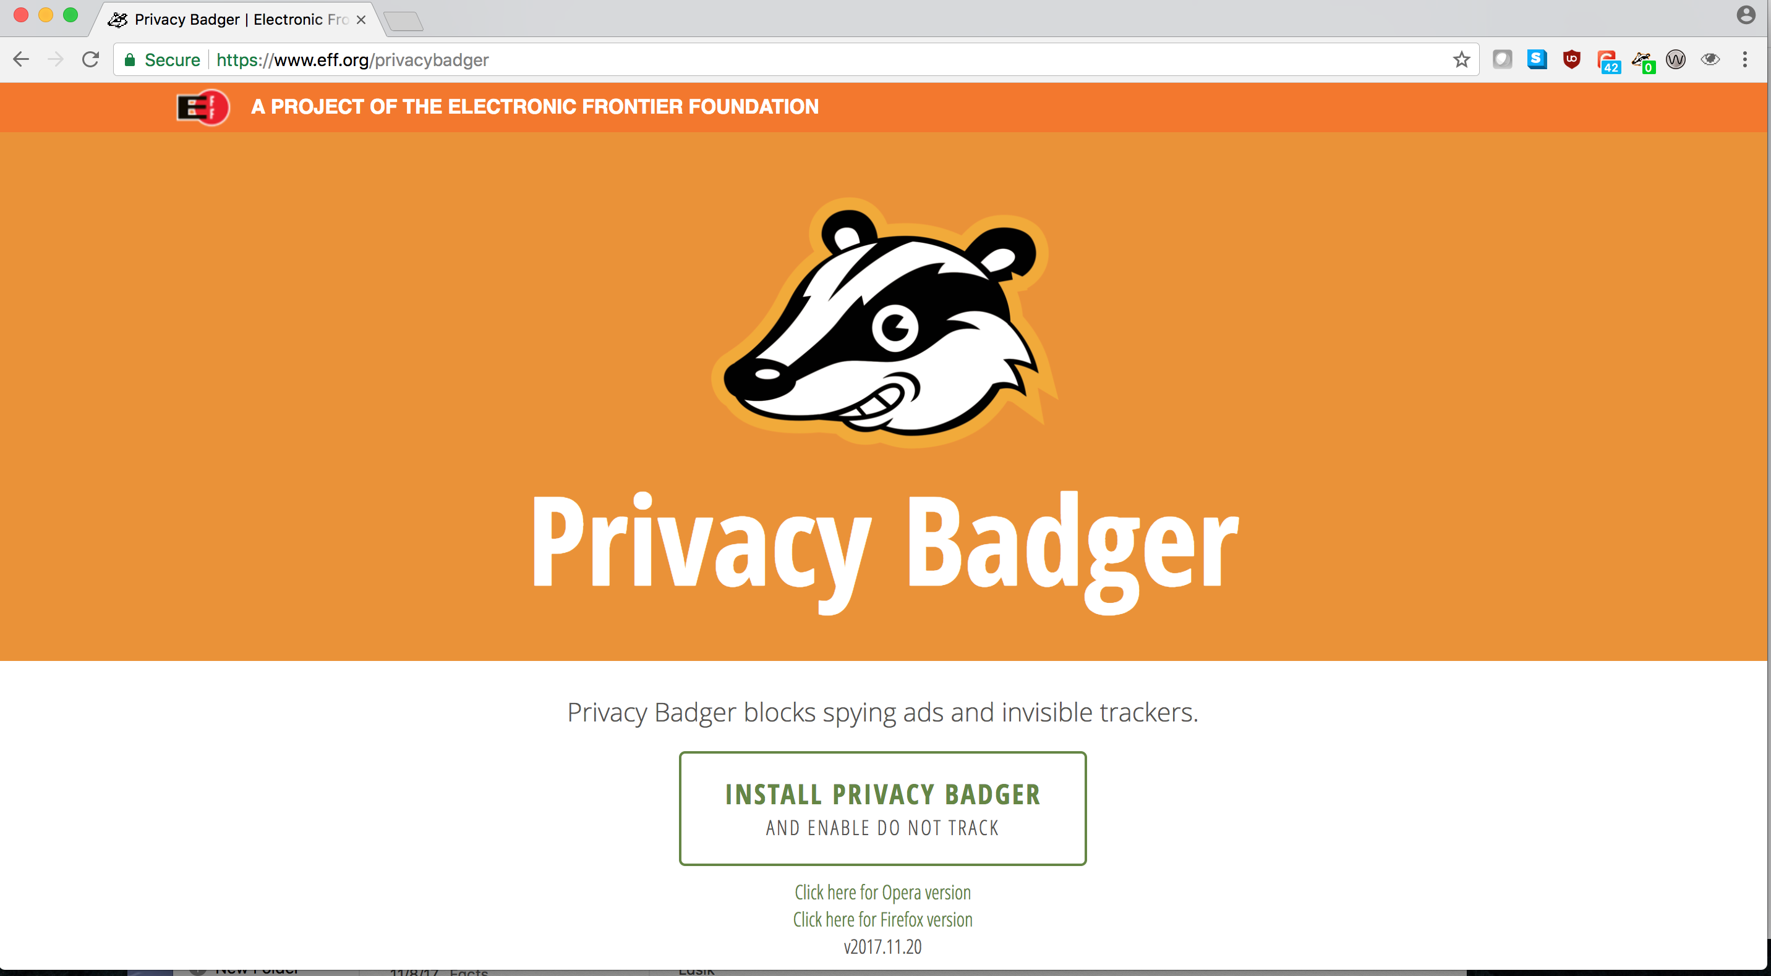

Slide 8
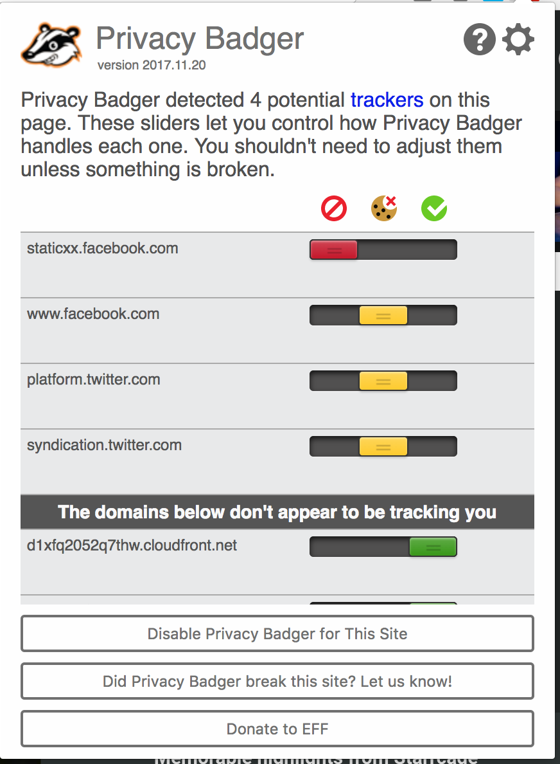
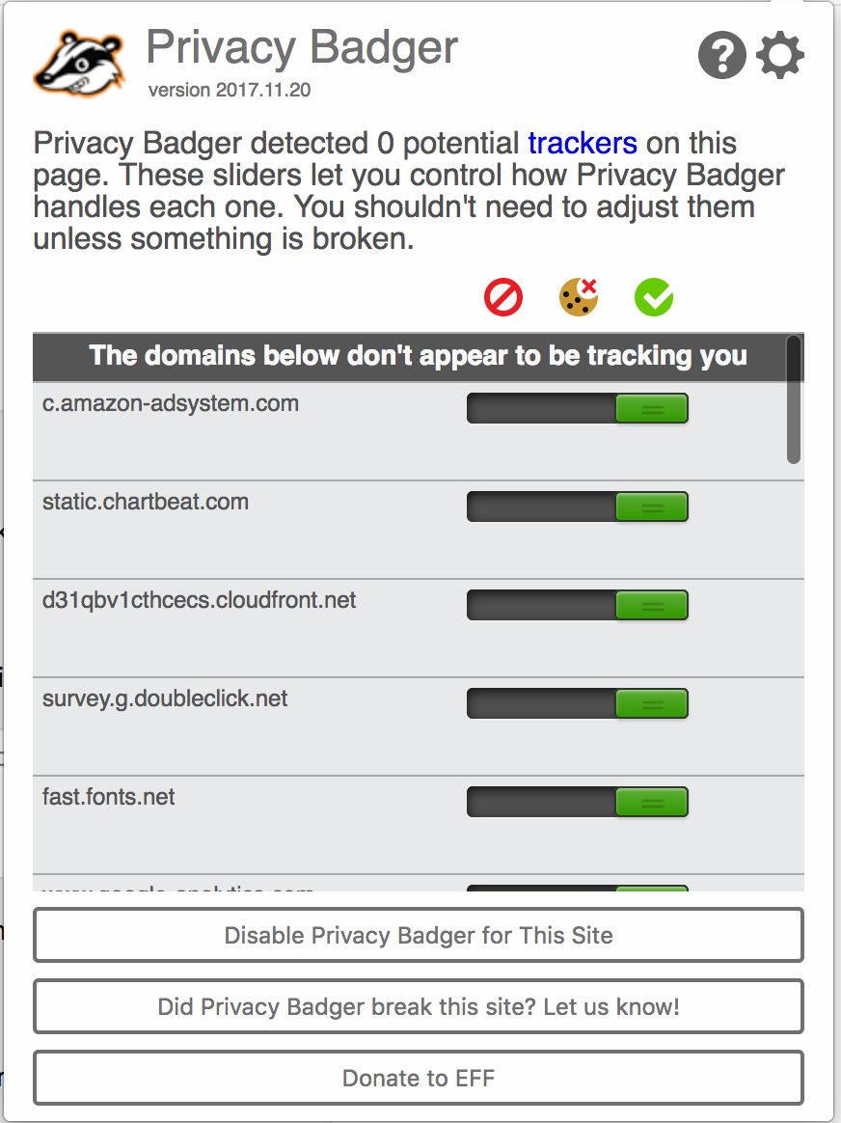
Notes:
stops advertisers and other third-party trackers from secretly tracking where you go and what pages you look at on the web. If an advertiser seems to be tracking you across multiple websites without your permission, Privacy Badger automatically blocks that advertiser from loading any more content in your browser
In our testing, all of them required some custom configuration to block non-consensual trackers. Several of these extensions have business models that we weren't entirely comfortable with. And EFF hopes that by developing rigorous algorithmic and policy methods for detecting and preventing non-consensual tracking, we'll produce a codebase that could in fact be adopted by those other extensions, or by mainstream browsers, to give users maximal control over who does and doesn't get to know what they do online..
Privacy Badger springs into action, telling your browser not to load any more content from that source. And when your browser stops loading content from a source, that source can no longer track you
When you visit a webpage parts of the page may come from domains and servers other
Privacy Badger analyzes each third party's behavior over time, and picks what it thinks is the right setting for each domain, but you can adjust the sliders if you wish. than the one you asked to visit. This is an essential feature of hypertext, but it has also come to be a serious privacy problem. On the modern Web, embedded images and code often use cookies and other methods to track your browsing habits — often to display advertisements. The domains that do this are called "third party trackers", and you can read more about how they work here.
even though you specifically denied consent by sending a Do Not Track header
Because Privacy Badger is primarily a privacy tool, not an ad blocker. Our aim is not to block ads, but to prevent non-consensual invasions of people's privacy because we believe they are inherently objectionable

Slide 9
Extensions/Plug-Ins
Help you keep your browser secure(er)
Firefox/Chrome (Pre-Installed on Brave and Tor)
Privacy Badger
HTTPS Everywhere
UBlock
Advanced: NoScript

Slide 10
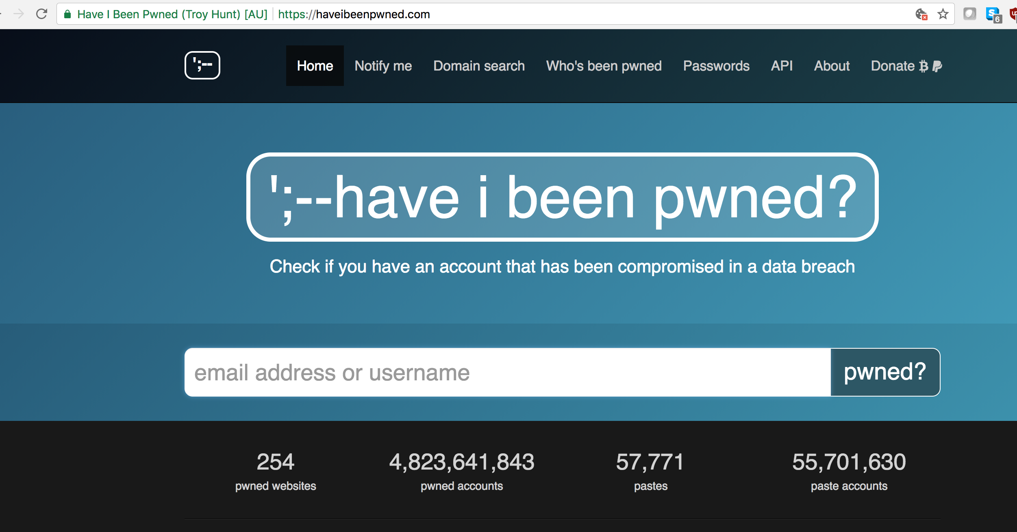
Notes:
Tor and EFF
Many sites on the web offer some limited support for encryption over HTTPS, but make it difficult to use. For instance, they may default to unencrypted HTTP, or fill encrypted pages with links that go back to the unencrypted site. The HTTPS Everywhere extension fixes these problems by using clever technology to rewrite requests to these sites to HTTPS. Information about how to access the project's Git repository and get involved in development is here.
See through straw vs opque straw
Someone can capture, search and read all of the text and images on all of webpages you get from websites.
Someone can capture, search and read all of the text and images that you upload and send to websites.
Someone could passively or actively collect, read, publish or sell information contained in or attached to all of your sent and received emails if you’re connecting with HTTP.
Someone could passively or actively collect your passwords and account information sent via HTTP, use them now or later to “pwn” your account, download your personal information (or that of your contacts), attempt to pwn your other accounts, sell your account information and data online.
Someone could masquerade as HTTPS-protected website and trick you into sharing sensitive information.
A malicious person could intercept your encrypted web traffic by masquerading as a trusted server.

Slide 11
Extensions/Plug-Ins
Help you keep your browser secure(er)
Firefox/Chrome (Pre-Installed on Brave and Tor)
Privacy Badger
HTTPS Everywhere
UBlock
Advanced: NoScript

Slide 12
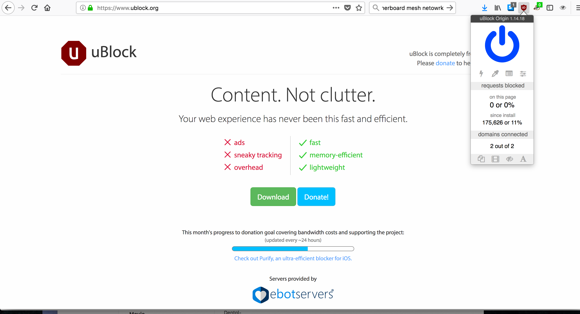

Slide 13
Extensions/Plug-Ins
Help you keep your browser secure(er)
Firefox/Chrome (Pre-Installed on Brave and Tor)
Privacy Badger
HTTPS Everywhere
UBlock
Advanced: NoScript

Slide 14
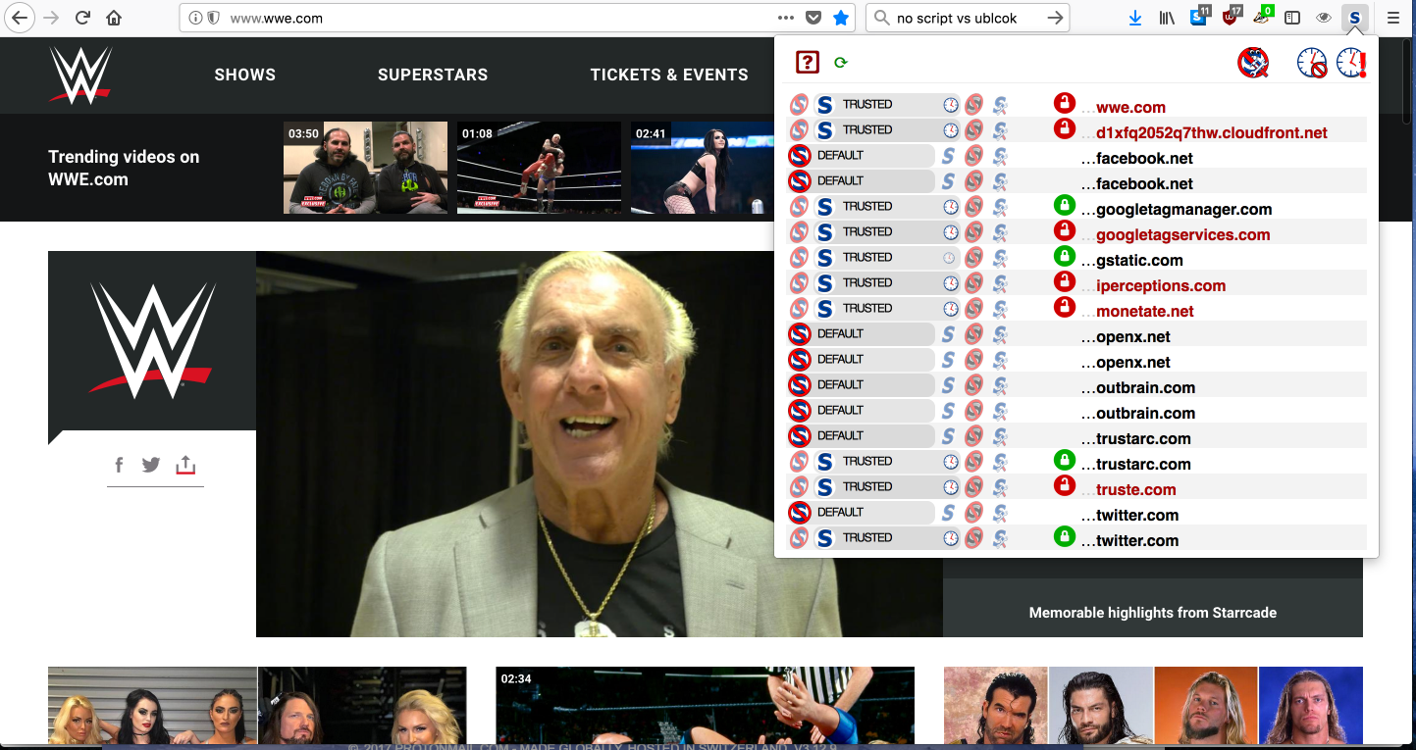

Slide 15

Browser FingerPrint
Your Browser Has a FingerPrint
Canvas Fingerpint
Screen Size/Color Depth
Browser Plugin
Timezone
Language
Platform
Browser and Computer
PanoptiClick (panopticlick.eff.org)
Notes:
Browser characteristics
Stored information: Any information you allow the browser to store such as passwords, addresses or credit card information
Browsing history: all of the websites you have visited in the past
Content: URL, text and images, and hidden content of past and current browsing
Your precise, physical location
IP address of the device being used to connect

Slide 16

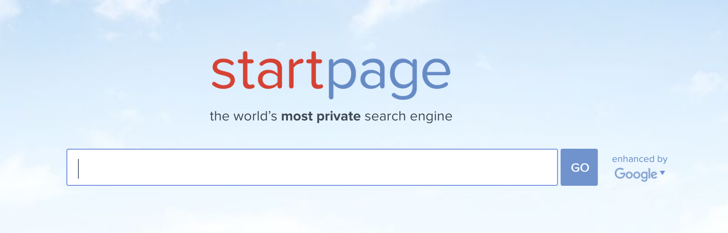
Alt. Search
DuckDuck Go (duckduckgo.com)
Doesn’t Store Personal Info
Don’t Store Search History
Doesn’t Track
Available for Mobile
StartPage (StartPage.com)
Acts As Intermediary between You and Google
Strip out cookies, doesn’t store IP,
Gives you option to connect to pages securely through Proxy
European Based

Slide 17

Going Forward
Data Detox- datadetox.myshadow.org/detox
HackBlossom- hackblossom.org/cybersecuirty
CryptoChristmas- crypto.christmas
EFF Surveillance Self-Defense- ssd.eff.org
MyShadow- myshadow.org

